Slide 1
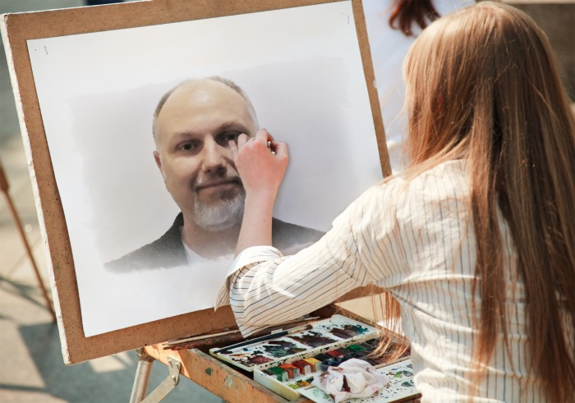
Creating your Best Presentation: A Speaker Workshop
Buck Woody
Notes:
Session Title
Creating Your Best Technical Presentation: A Speaker Workshop
Session Description\Abstract
Communication is one of the most important skills in business – and technical professionals have a difficult task in creating, preparing and delivering pertinent content to their audiences. Whether it’s presenting to your peers on a technical topic or making the complex understandable for a more general audience, it takes great skill to deliver a compelling presentation. In this session, Buck Woody, a Senior Technical Professional from Microsoft with consistently high scores at TechEd, PASS and other conferences will show you how to create a great presentation. It’s a workshop-style event, so you’ll be asked (right from the start) to get hands-on and learn from Buck and your peers on how to select a compelling topic, research and deliver a great session. It’s eight hours of useful information and practice that will prepare you to present at events from user groups to professional associations.
Session Agenda with topics to be covered
This is a workshop-style session. That means that each attendee will be required to prepare and deliver a mini-session that will be refined throughout the day. Laptops and Internet Connectivity is required.
In this workshop, you’ll learn and practice the following topics:
Selecting a Topic – Creating the best headlines to attract and audience and describe your session
Researching Skills – Sources and presentation methods of obtaining the most authoritative background information
Delivery Mechanics – From PowerPoint to simple whiteboard presentations, the best way to use the tools at hand
Dealing with Difficulties – Working with distractions, technical failures and hostile audiences
Selecting your Audience – You’ll have to sign up to learn more about this topic
Verbal Skills and Confidence – Learn and receive feedback on how you project, clarity, and methods to gain confidence in your presentation skills.
Resources and Notes:
Exercises:
http://www.skillsconverged.com/FreeTrainingMaterials/tabid/258/articleType/CategoryView/categoryId/124/Presentation-Skills.aspx
Time checks
http://mhhe.com/socscience/english/tc/pt/oral/exercises.htm
http://library.leeds.ac.uk/tutorials/activities/presentations/voice-exercises/
http://effective-public-speaking.com/
http://www.ehow.com/how_5506911_create-good-thesis.html
http://writing.wisc.edu/Handbook/Thesis.html
http://writingcenter.unc.edu/handouts/thesis-statements/

Slide 2
Assignment
Deliver a 5-Minute presentation on a topic assigned to you. You have 10 minutes to prepare.
Notes:
Questionnaire:
Presenter Name:
Topic Assigned:
Time - Number of seconds away from 5 minutes:
Message - Clear, Semi-Clear, or Unclear:
Speech Cadence – Too fast, just right, too slow:
Main Point – what was the overall point of the presentation:
Supporting Points – Did all information lead to the main point (elaborate):
Action call – What did the presenter want you to do? Did they equip you to do it?:
Why was the exercise difficult? Too much data needed? WRONG!
In order to learn something, people don't have to be told everything. Don't try to make them eat from a data trough.
You are the storyteller, not your slides.

Slide 3
Agenda
Selecting the Subject
Researching and Composing
Selecting Your Audience
Verbal Skills and Confidence
Delivery Mechanics
Dealing with Difficulties

Slide 4
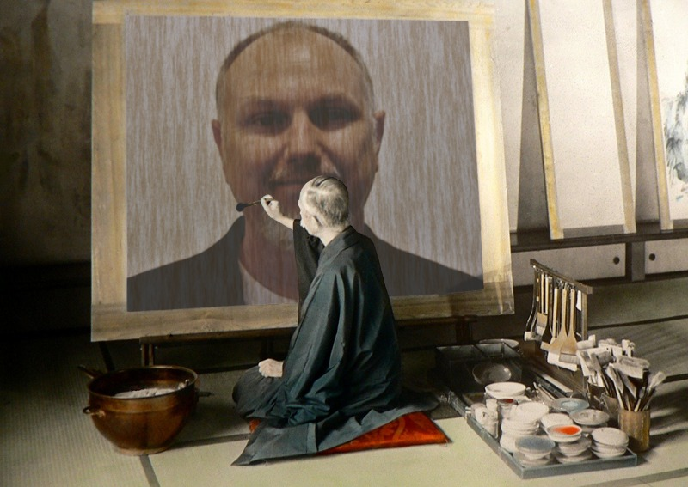
Selecting the Subject
Notes:
Presenting = selling, like it or not. Learn to sell. If you don’t believe it, neither will your audience. If you aren’t enthusiastic about it, your audience won’t be either.

Slide 5

Content is NOT King
Topic Types:
Features and Benefits
Case Study
Modular
Compare and Contrast
Notes:
Your main point is the king. Contents are the pawns.

Slide 6
Headlines Sell
Creating the topic and abstract:
What does this mean?
Why is this important? Why should you care?
Why am I telling you this?
What will you learn?
What are you going to do about it?
Notes:
Grab them in the first sentence.

Slide 7
Assignment
Rewrite the title to your topic
Choose a different content type for your presentation
Create an abstract as if wrote the product and your complete income depended on your selling it. Make it bigger than life – then reduce it.

Slide 8
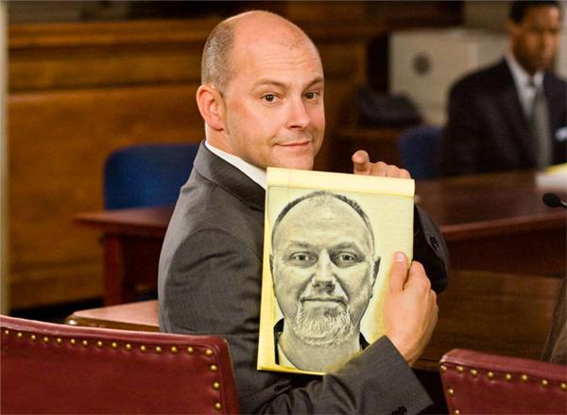
Researching and Composing
Buck Woody
Notes:
Put yourself on the side of the audience – they do NOT know what you want them to know!
Read with a pencil – stop on what you like

Slide 9
Preparation Structure
Main Points
Graphics
Animations and Theming
Notes:
First get your main thought
Then figure out your main points that support it – these become slides
Lay in graphics that will support the slide
Then add animation to show progression, and theme it to be easy to look at and read. 10-foot rule

Slide 10
Go with the flow
Flow Options:
Process
Chronological
Problem and Solution
Notes:
Every point should lead to the next point, and all points should lead to the main point. Supporting points are like a therapist – hands never leave the body.
Simple terms are better.

Slide 11
Everybody loves a good story
Creating a story:
Characters – Settings -Situations
Beginning – Middle - End
Conflict is essential
Notes:
Stories:
Always include a story. A good story forms the foundation for your delivery, but the reverse is never true.
Always create a story – elements are:
Characters
Settings
Situations
20 Master Plots
Telling a story:
People, Places, and Situations (Conflict is essential)
Flow – Beginning, Middle and End
Components – Characters, Situation and Plot

Slide 12
The Demo Dilemma
Demo the point only
Visibility
Practice and Backup
Notes:
Remember the fonts
Duplicate on Blog

Slide 13
Assignment
Write one scene using the following elements:
Characters: Yvonne, Christina, Douglas (don’t call me Doug, I hate that), Buddy, “Skeets”
Setting: Biological Hazard Lab
Situation: Your scenario
Include conflict.

Slide 14
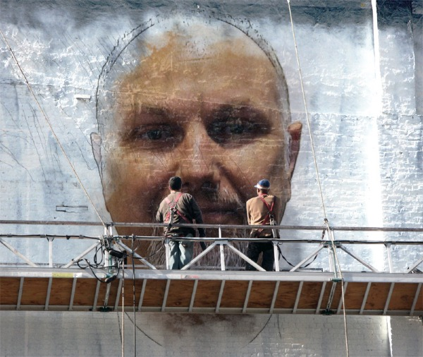
Selecting Your Audience
Notes:
Define your audience – that's the key to writing a good pitch.
Define your level – explain the tech/concepts and so on that you plan to cover. What should they know beforehand and so on.
Ask the questions you know your audience will ask.

Slide 15
Pitch it, pitch it real good
What does your audience know?
What do they need to know?
What will you tell them?
What will they learn how to do/need to do/want to do?
Notes:
http://www.brentozar.com/archive/2012/04/writing-better-conference-abstracts-presentations/
http://sqlblog.com/blogs/adam_machanic/archive/2013/02/22/capturing-attention-writing-great-session-descriptions.aspx

Slide 16
Involve the Audience
Ask Questions
Urge Interactions
Encourage Active Listening

Slide 17
Assignment
Write an abstract that has these elements:
The person that attends this session knows:
The person that attends this session wants to learn:
The person that attends this session has been working in this technology for:
The person that attends this session wants to able to:

Slide 18
Takeaways
Selling Skills
What’s in it for them?
Keep it real
Answer the questions

Slide 19
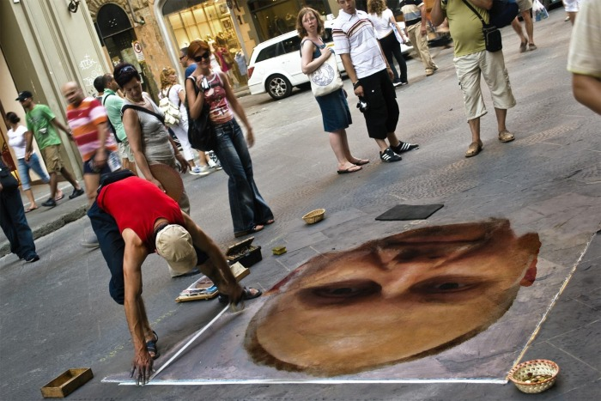
Delivery Mechanics
Notes:
Opening can be a story, question or fact.
All elements should lead to the point.
Graphics should show state or movement – never lists - exercise
Two fonts only
Fewer is better
URL's for Handouts
Tie everything back together – exercise on phrases to do that.
Prep early – always.
Voice practice – investigate this?
Knowledge and practice removes fear every time.

Slide 20
Deck management
Graphics for state and movement
Simple/ Fewer is better
MAKE YOUR FONTS BIGGER
Use the Presentation View
Print your Notes View
Use Zoom Keys (Win + and Win Esc)
Notes:
Prep early – always.
Knowledge and practice removes fear every time.

Slide 21
Session management
Get there early
Repeat the Question
Slow down
Be enthusiastic!
GET OFF THE STAGE
Notes:
Prep early – always.
Knowledge and practice removes fear every time.

Slide 22
Assignment
Create a Deck for your presentation using only:
Text
Lines
Rectangles
Triangles
Circles

Slide 23
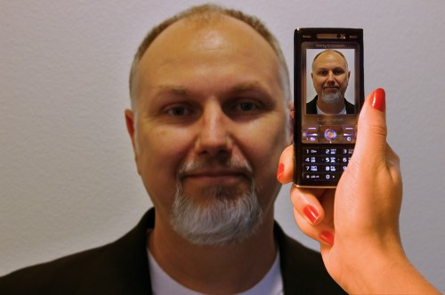
Verbal Skills and Confidence
Notes:
Teleology: Starting with the end in mind.
Flow control – describe a meal out of order. Then describe it in order. Put your presentation into a meal - taste, how you made it, what you need, instructions.

Slide 24
Time management
Pacing and Timing
Everything should lead to the point
Every slide is a cliffhanger
URL’s for references
Notes:
Everything comes down to time management
Opening can be a story, question or fact.
All elements should lead to the point.
Tie everything back together – exercise on phrases to do that.

Slide 25
Practice Makes Perfect
Time checks
No Uhms
Know what you want to say
Landmarks not turn-by-turn
Notes:
No substitution for practice

Slide 26
Assignment
Speaker: Make signposts for your main points on the floor. Walk them as you talk.
Actor: Charades as they go
Notes:
Body Language:
Each time you indicate direction, point. Each time you indicate a technology, walk.

Slide 27

Dealing with Difficulties
Notes:
As you prepare, find the points of resistance and determine what you are going to do about them.

Slide 28
Technology
High Tech
Low Tech
No Tech
Notes:
Contact Info and Method
LinkedIn Info

Slide 29
People
Honest Question
Lack of clarity
Angry/frustrated
Needs a stage
Always repeat the question

Slide 30
Assignment
Write as many issues that might occur during your presentation as you can think of – be specific
Write out your possible responses – be specific
Notes:
Create three presentations: High Tech, Low Tech, and No Tech.
Write out as many objections that you cannot answer as you can, and deliver a response for it.

Slide 31
Assignment
5-Minute Presentation on the topic assigned to you. How is it different?
Notes:
Questionnaire:
Presenter Name:
Topic Assigned:
Time - Number of seconds away from 5 minutes:
Message - Clear, Semi-Clear, or Unclear:
Speech Cadence – Too fast, just right, too slow:
Main Point – what was the overall point of the presentation:
Supporting Points – Did all information lead to the main point (elaborate):
Action call – What did the presenter want you to do? Did they equip you to do it?

